Slide 1
Pen Pal
AI powered security analysis for penetration testers
Brandon Herbert

Slide 2
Summary
Pen Pal is an AI powered assistant that will analyze web requests as you conduct a penetration test for a web application.
Findings are automatically displayed in the browser in real time.
Possible attack vectors are highlighted with example payloads.
Great at identifying hidden routes and sensitive data that may often be overlooked.

Slide 3
Example pen test: Juice Shop
Juice shop is an intentionally vulnerable web application.
Great for practicing the basics of web application penetration testing.
Designed for beginners and also contains harder to find vulnerabilities.

Slide 4
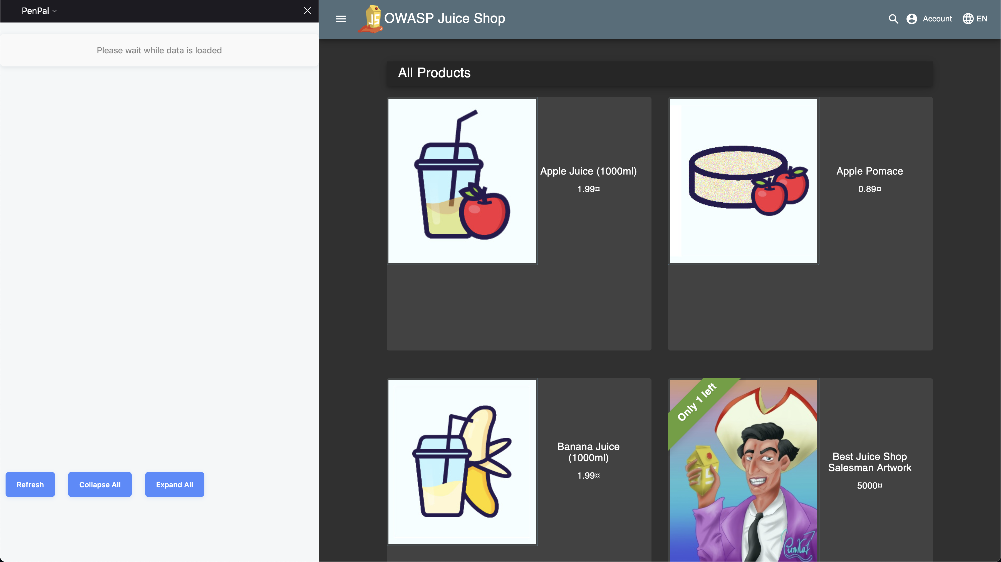
The Pen Pal extension is displayed on the left hand side of the browser.

Slide 5
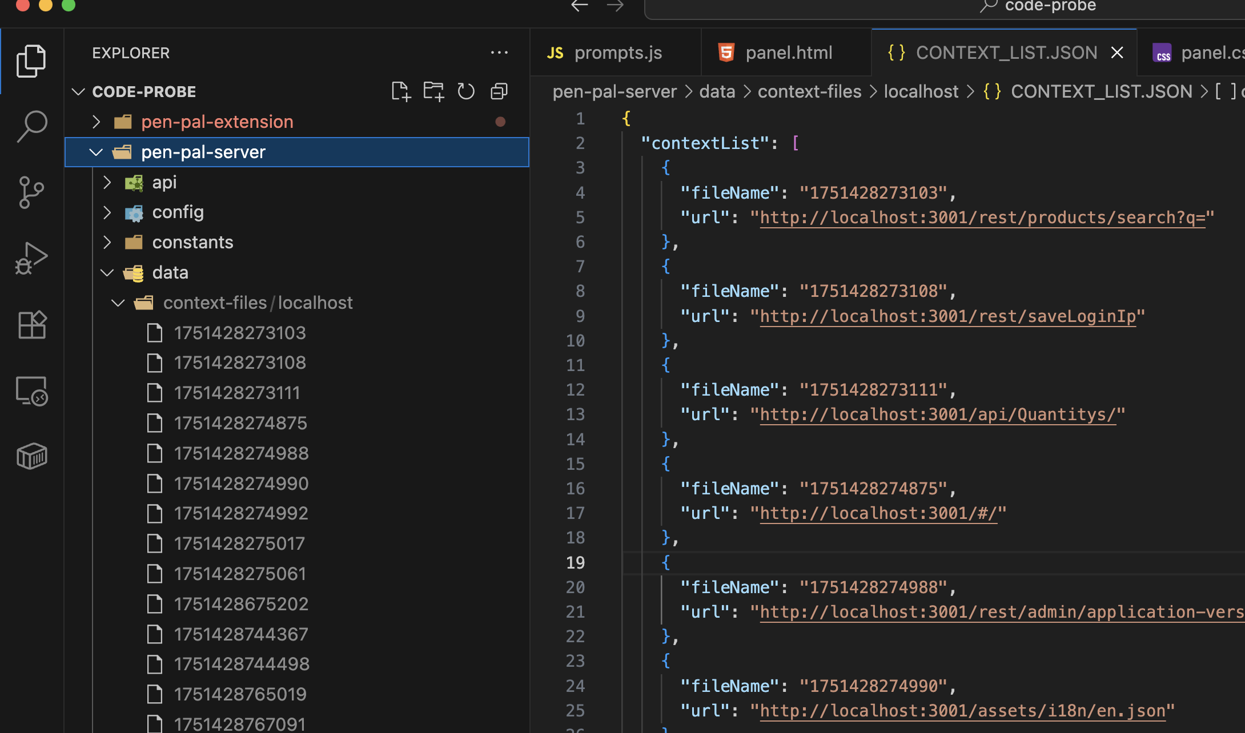
Source files and request responses are analyzed in real time as the tester uses the web app.

Slide 6
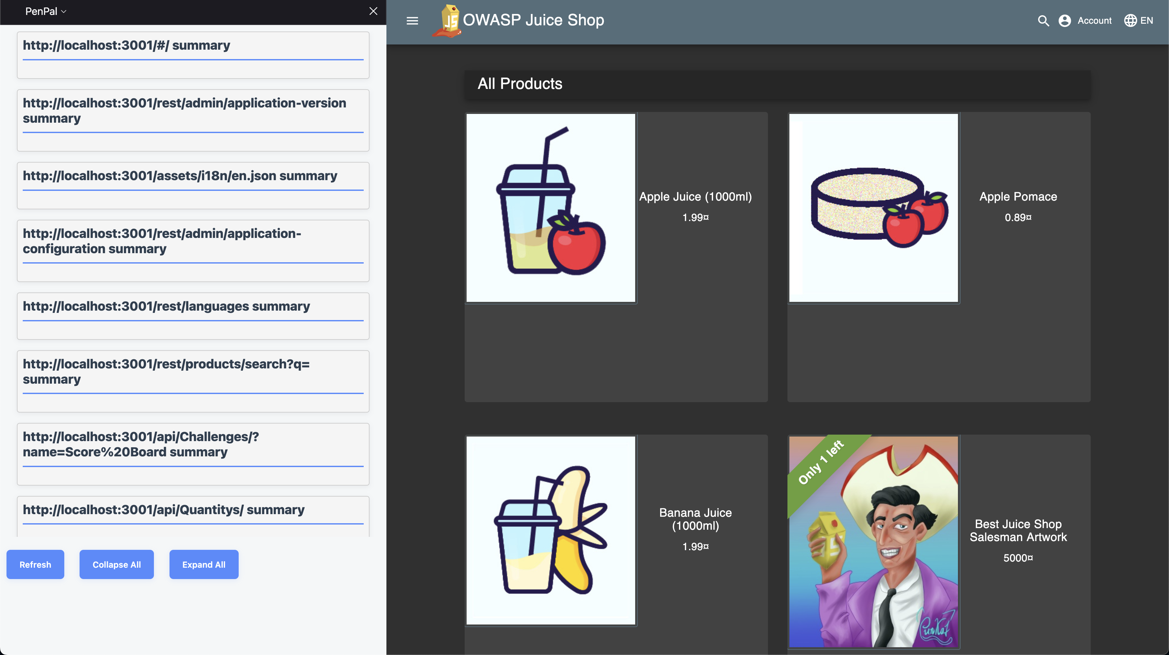
Analysis is auto populated in the side panel as each request is analyzed.

Slide 7
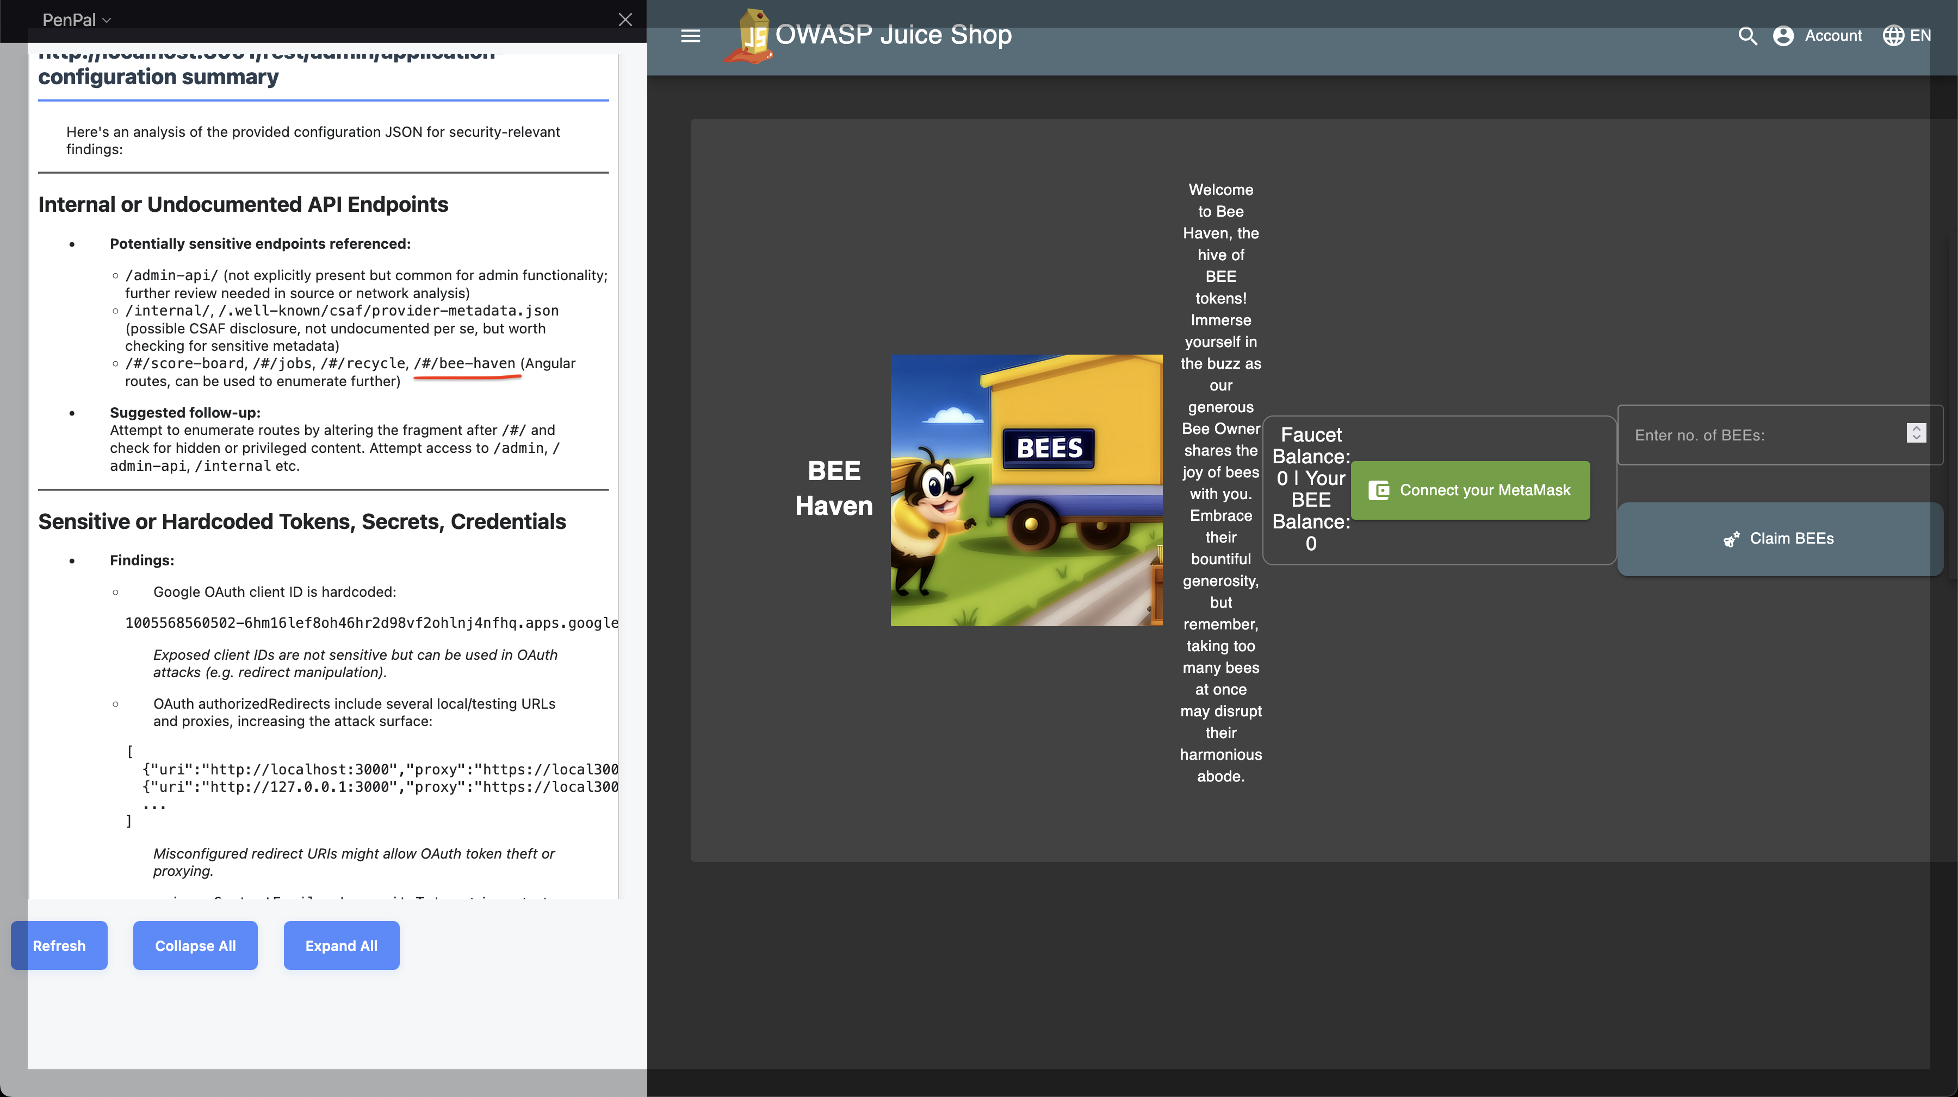
Unlisted route /#/bee-haven found mentioned in configuration files.

Slide 8
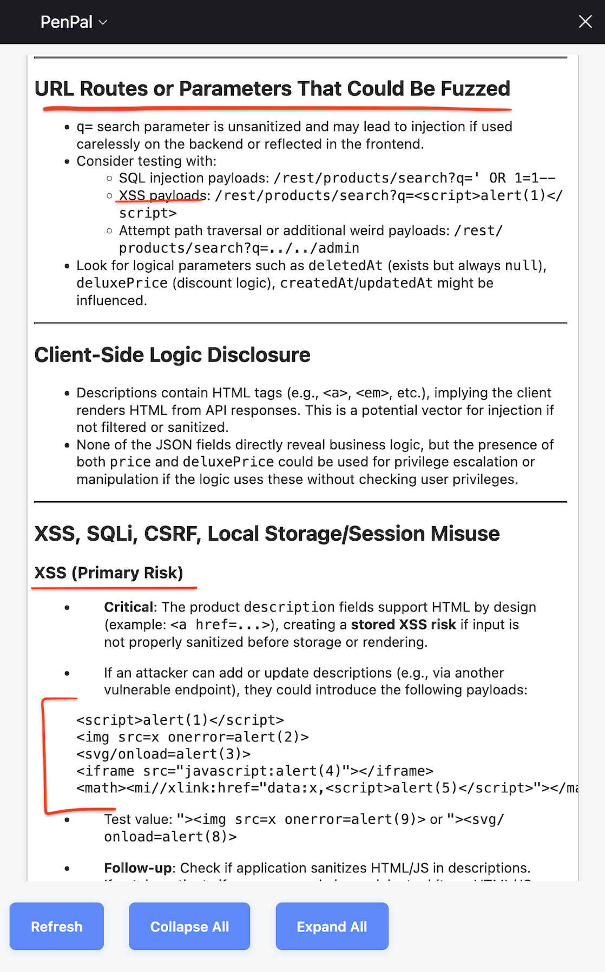
Analysis for product search route.

Slide 9
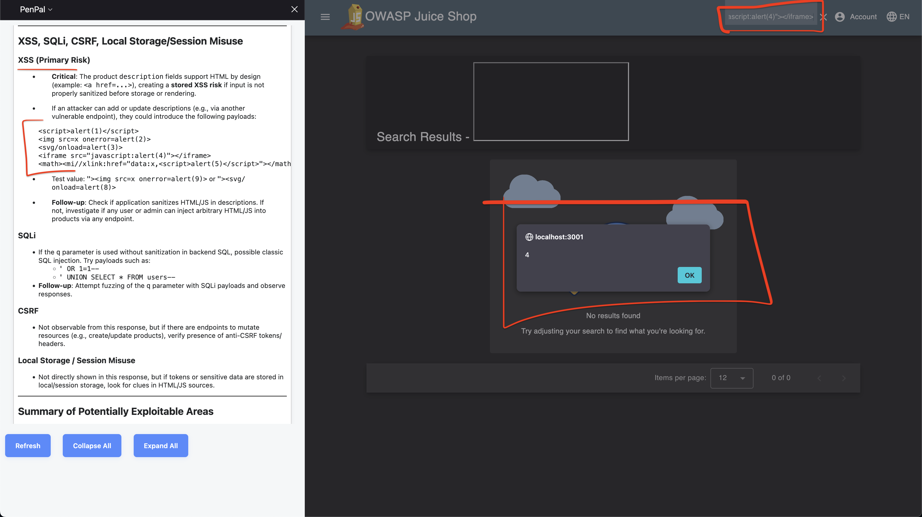
Utilizing suggested payload to find XSS vulnerabilities.

Slide 10
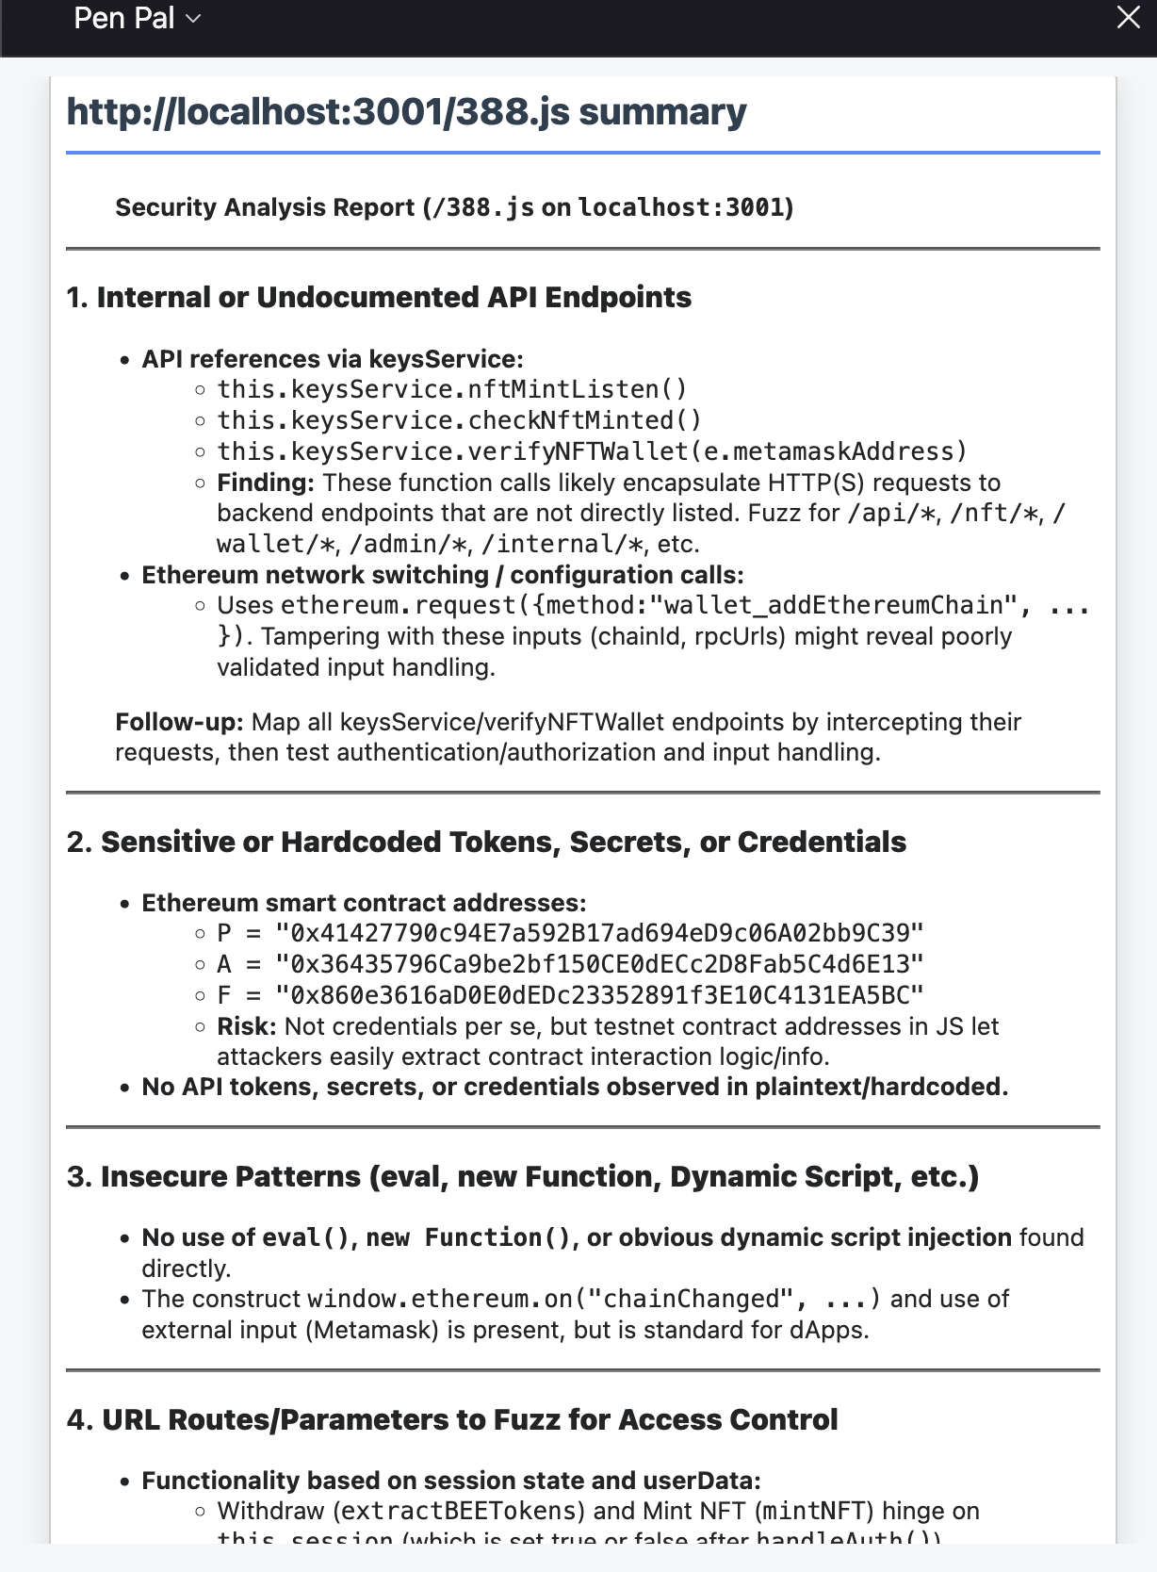
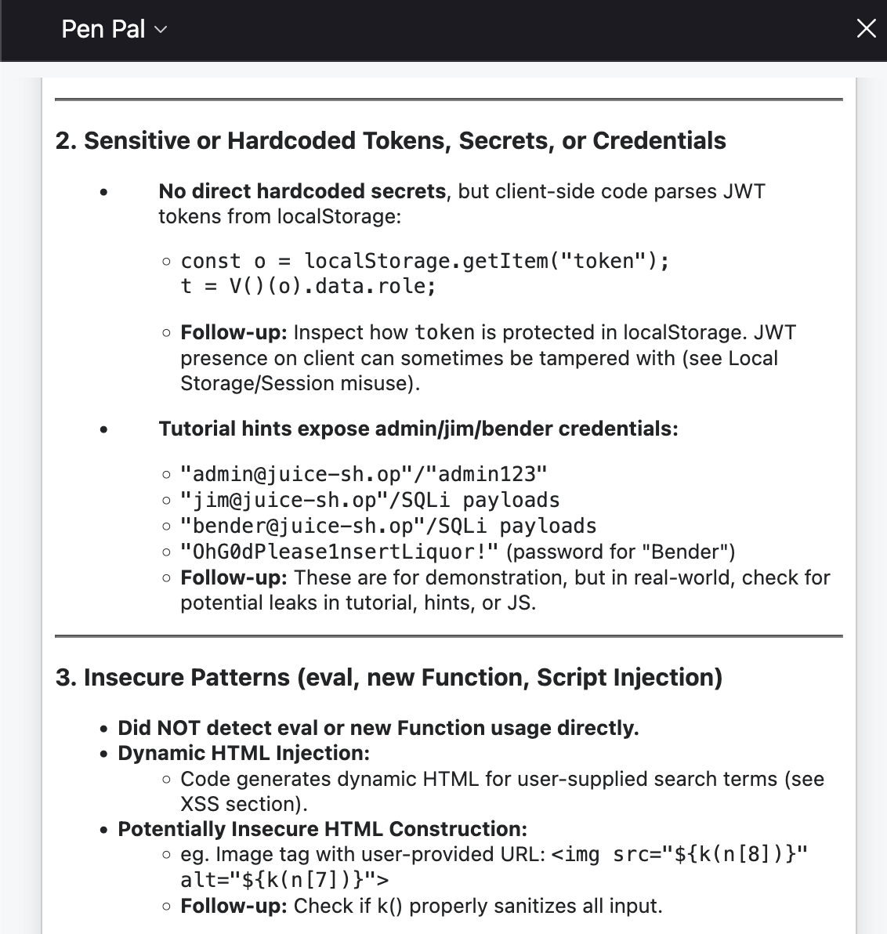
Sensitive data found in source files.

Slide 11
Next steps
Allow request payloads to be analyzed for possible vulnerabilities (XSS & SQLi, Fuzzing suggestions).
Store analysis in a database rather than local JSON files.
Create a better UI or even a standalone UI that can be shared by a team of testers.
Optimize prompts to get better analysis and suggestions.

